Slide 1
Handware study
on distributed multi-robot system
Aixi Guo
Oct 13, 2018

Slide 2
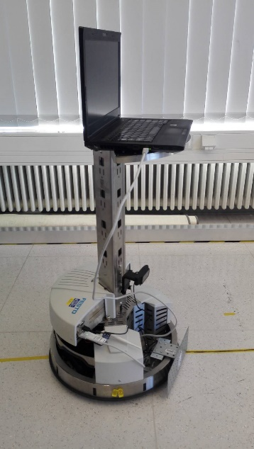
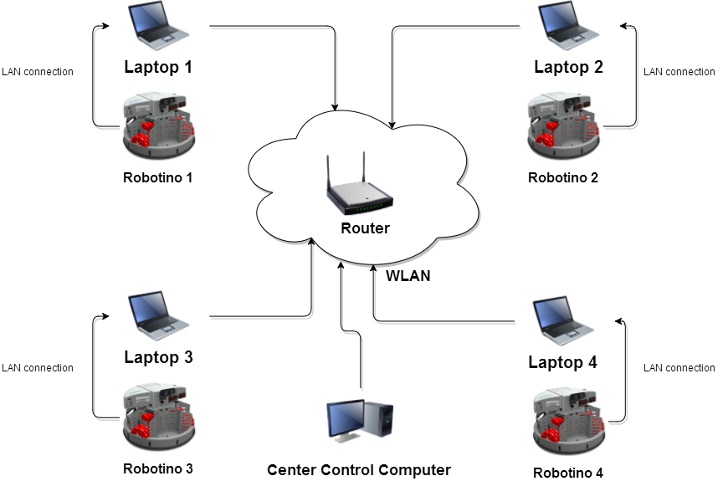
Hardware Connection Plan
- Plan A: Robotino with laptop

Slide 3
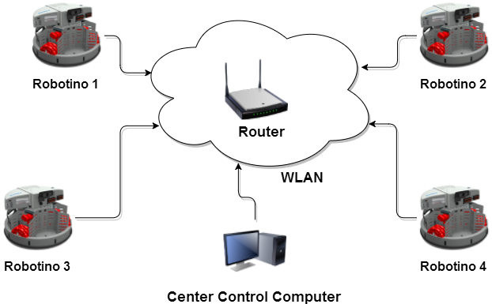
Hardware Connection Plan
- Plan B: Robotino without laptop

Slide 4
Hardware Connection Plan
Comparision
Support Software
comparison | Plan A | Plan B
MATLAB/Simulink | Yes | No
C++&OpenCV | Yes | Yes
Unity | Yes | No
JAVA | YES | YES
NET | YES | YES
LabVIEW | YES | Not sure
Robotino View | YES | YES
PLAN A
Plan A can support more software.
Plan B need move current platform from windows to Linux
PLAN B

Slide 5
Hardware Connection Plan
Comparision
Support Software
Support Technik
comparison | Plan A | Plan B
Robot Control | Yes | Faster
Image Process | Faster And Advance | Slow And Basic
Cooperation | Yes | Yes
PLAN A
Plan A is better( 50–100 times faster ) when using GPU for image processing*
https://medium.com/altumea/gpu-vs-cpu-computing-what-to-choose-a9788a2370c4
PLAN B

Slide 6
Hardware Connection Plan
Comparision
Support Software
Support Technik
Conclusion
Plan A needs extra laptops for each Robot.
Plan A has powerful functionality, like image processing.
Plan A doesn’t change current platform.
Plan A support more software(like Matlab)
Plan B has the simple hardware structure.
Plan B costs more less.
Plan B needs transform current platform to linux.
PLAN A
PLAN B

Slide 7
Distrubute System For Robot
Distrubute System For Robot
No matter which kind of hardware plan is choice, we need a distribute system for robot. This distribute system handles following tasks:
Build up a local network.
Transmission data through the network.
Physical data: position, speed, distance…
Command data: start to move, stop, setting target…
Supply interface for other project.
toolbox for matlab.
C/C++ function interface.

Slide 8
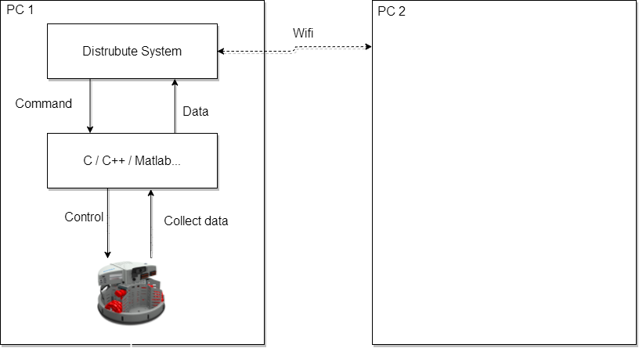
Distrubute System For Robot
Distrubute System For Robot

Slide 9
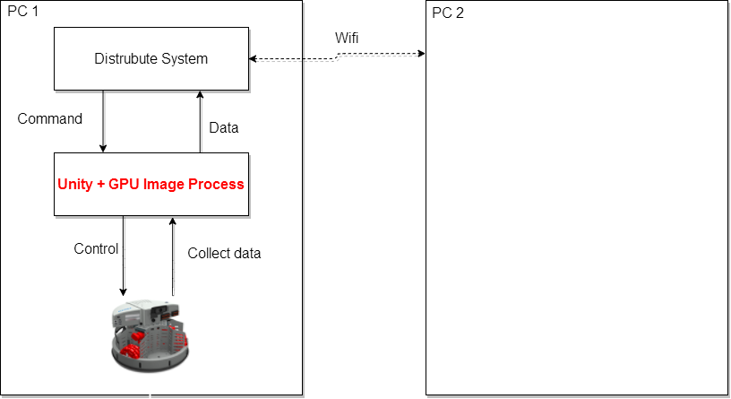
Distrubute System For Robot
Topic: Distrubute control base on image process

Slide 10
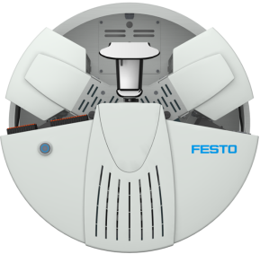
Distrubute Control Example
target
1
2
3
1
1
2
3
1
target
3
2
3
2
target

Slide 11
Thank you for your valuable time
and your attention.

